Slide 1

Practical 5
Infix to Postfix Conversion Using Shunting Yard Algorithm

Slide 2

Lesson Plan
Subject/Course | Competitive Coding
Lesson Title | Infix to Postfix Conversion Using Shunting Yard Algorithm
Lesson Objectives
Understand infix, prefix, and postfix notations and their role in expression evaluation.
Implement the Shunting Yard Algorithm to convert infix to postfix using a stack for operators and a queue for output.
Handle operator precedence, associativity, and parentheses correctly.
Apply this to real-world scenarios like compiler design and competitive problems.

Slide 3
Problem Statement:
Write a Program for an infix expression, and convert it to postfix notation. Use a queue to implement the Shunting Yard Algorithm for expression conversion.
Given an infix expression (e.g., "A + B * C"), convert it to postfix (Reverse Polish Notation, e.g., "A B C * +") for easier evaluation without parentheses.
Input (Infix) | Output (Postfix) | Explanation
A + B * C | A B C * + | * has higher precedence than +.
(A + B) * C | A B + C * | Parentheses group A + B first.
A ^ B ^ C | A B C ^ ^ | ^ is right-associative.

Slide 4
Key Concepts & Prerequisites
Infix Expression: Operators appear between operands. Example: A + B * C Problem: Harder for computers to evaluate due to precedence rules.
Postfix Expression (Reverse Polish Notation): Operators come after operands. Example: A B C * +
Advantage:
No need for parentheses.
Evaluation becomes simpler using a stack.

Slide 5
Key Concepts & Prerequisites
Shunting Yard Algorithm: Uses:
Stack → For operators and parentheses.
Queue → For the final output (postfix form).
Prerequisites:
Basic stack/queue operations
Understanding of operator precedence (e.g., * > +) and
associativity (left/right).

Slide 6
Algorithm/Logic
High-Level Approach
Scan input left-to-right.
Output operands immediately to queue.
Push '(' to stack; Pop until matching ')' for parens.
For operators: Pop lower/equal precedence from stack to queue, then push current.
At end, pop all stack to queue.

Slide 7
Algorithm/Logic
Detailed Algorithm
Initialize an empty stack (for operators) and an empty queue (for output).
Read tokens (operands/operators/parentheses) from left to right.
If token is operand → add to queue (output).
If token is operator (op1) →
While there is an operator (op2) at the top of the stack with greater or equal precedence, pop op2 and add to queue.
Push op1 onto the stack.

Slide 8
Algorithm/Logic
Detailed Algorithm
If token is ‘(’ → push to stack.
If token is ‘)’ → pop operators from stack to queue until ‘(’ is found; discard both parentheses.
After reading all tokens → pop all remaining operators from stack to queue.
Operator Precedence: ^ (highest), *, /, then +, -

Slide 9
Visualization
Step | Input Token | Stack (Operators) | Queue (Postfix Output)
1 | A |  | A
2 | + | + | A
3 | B | + | A B
4 | * | + * | A B
5 | C | + * | A B C
6 | End |  | A B C * +
Final Output: 🟩 Postfix → A B C * +

Slide 10
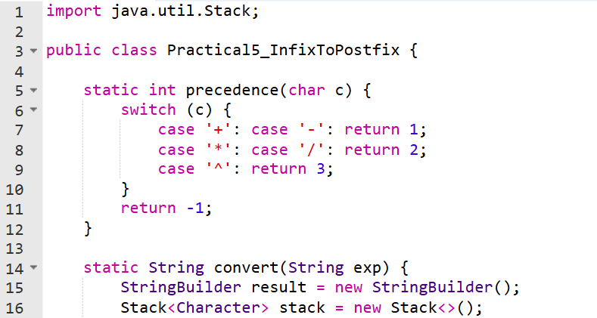
Code Implementation

Slide 11
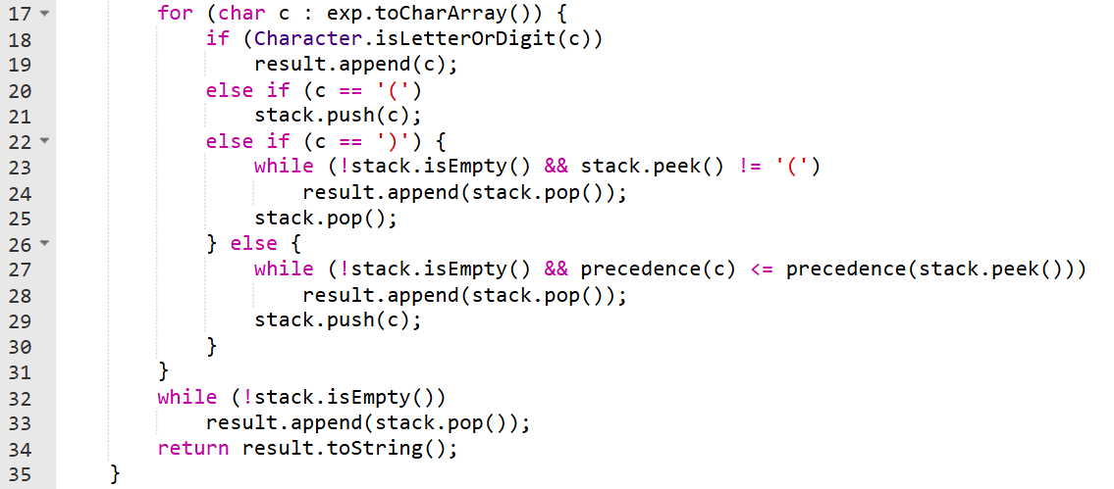

Slide 12
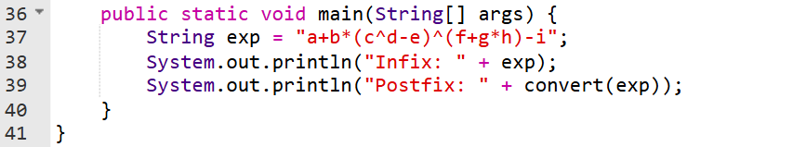

Slide 13
Output :
Infix: a+b*(c^d-e)^(f+g*h)-i
Postfix: abcd^e-fgh*+^*+i-

Slide 14
Complexity Analysis
Time Complexity: O(n) — each token processed once
Space Complexity: O(n) — for stack + queue

Slide 15
Variations & Competitive Tips
Easier Variation: No associativity (assume all left).
Harder: Add unary operators (e.g., -A); Handle variables/functions
Competitive Angle: LeetCode #159: Expression Add Operators; Codeforces problems on parsers.
Optimization: Use array for stack (faster in C++); Extend to full evaluator.

Slide 16
Practice Exercises
1️⃣ Evaluate Reverse Polish Notation — LeetCode #150 🔗 https://leetcode.com/problems/evaluate-reverse-polish-notation/ Concept: Postfix (RPN) evaluation using stack operations. Why Practice: It directly applies the postfix conversion and evaluation logic you learned.

Slide 17
Practice Exercises
2️⃣ Basic Calculator II — LeetCode #227 🔗 https://leetcode.com/problems/basic-calculator-ii/ Concept: Stack-based infix expression evaluation with + - * /. Why Practice: Reinforces understanding of operator precedence and stack evaluation.

Slide 18
Practice Exercises
3️⃣ Basic Calculator — LeetCode #224
🔗 https://leetcode.com/problems/basic-calculator/Concept: Evaluate arithmetic expressions with parentheses.Why Practice: Strengthens your ability to parse infix expressions with nested operations.

Slide 19
Thanks

